Slide 1
Highway Performance Monitoring System
Tom Roff
HPMS and ARNOLD Program Manager

Slide 2
Measures
How long is the Highway System? (Length)
What is the Capacity of the Highway System?
(Number of Lanes)
How much is the Highway System being used?
(Vehicle Count)
Dimensioned by Jurisdiction, Condition, Use, Ownership etc.

Slide 3
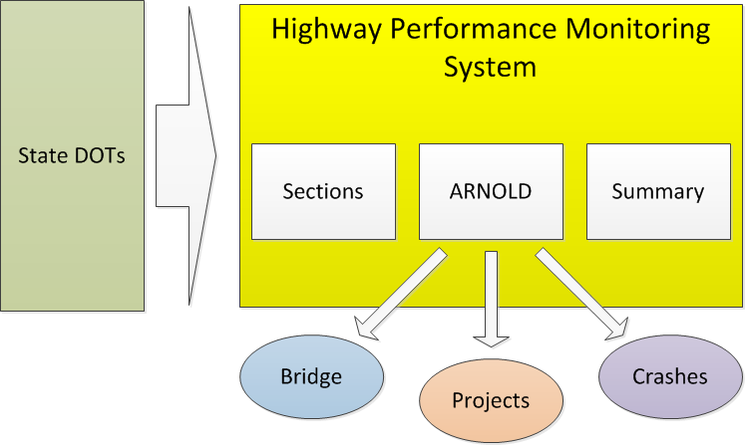
HPMS

Slide 4
What is Linear Referencing and Dynamic Segmentation?
Route : I50
15
11
27
30
7
0
Project_ID | Route_ID | Begin_Point | End_Point
Improv1 | I50 | 8.0 | 17.0

Slide 5
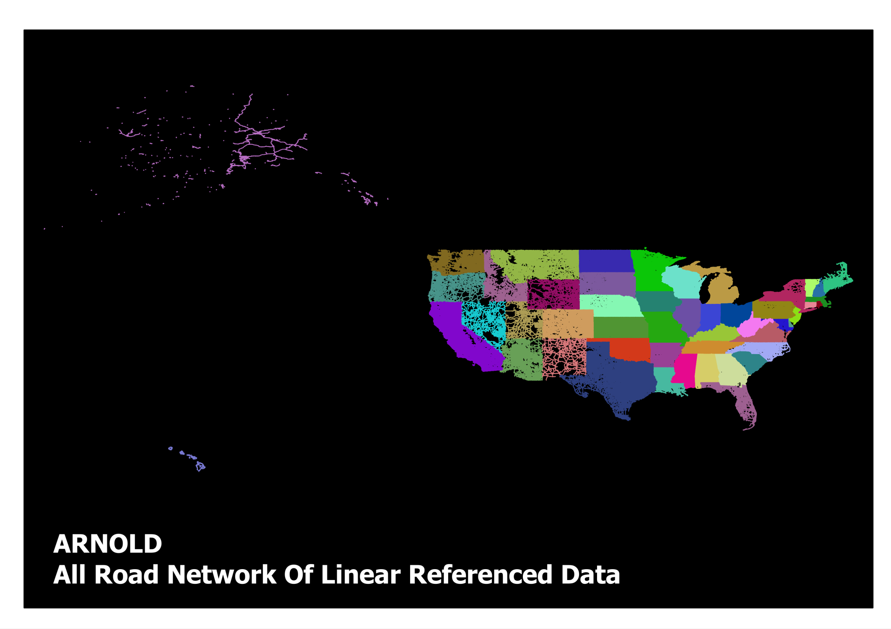

4.1 Million Miles

Slide 6
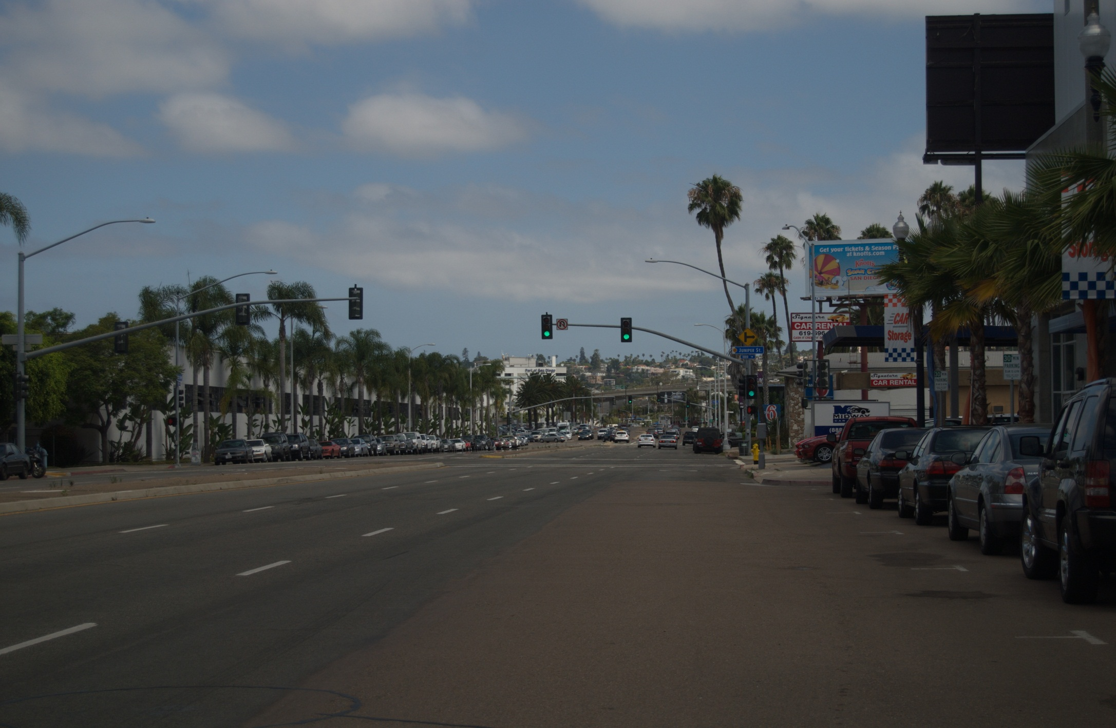
There are 63 Road Characteristics that HPMS collects
Inventory
Jurisdiction
Traffic
Pavement Condition
Capacity
Geometrics
Signals
Traffic Volumes
Intersections
Median Type
Lane Width
Roughness, Cracking , Faulting, Rutting
Parking

Slide 7
Summary Data
Limited information about Local Roads Summarized by County
Ownership
Surface Type Paved or Unpaved
Length
Location

Slide 8
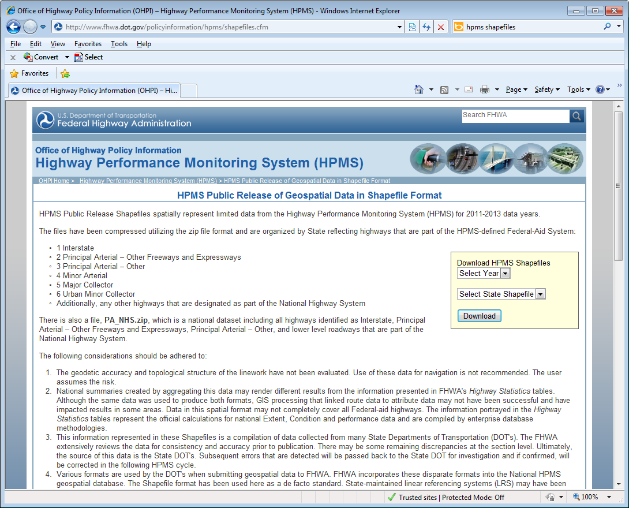
Where is the Data?
http://www.fhwa.dot.gov/policyinformation/hpms/shapefiles.cfm
Or
Google “HPMS Shapefiles”

